Slide 1
Approach for MSMQ Replacement on Azure

Slide 2
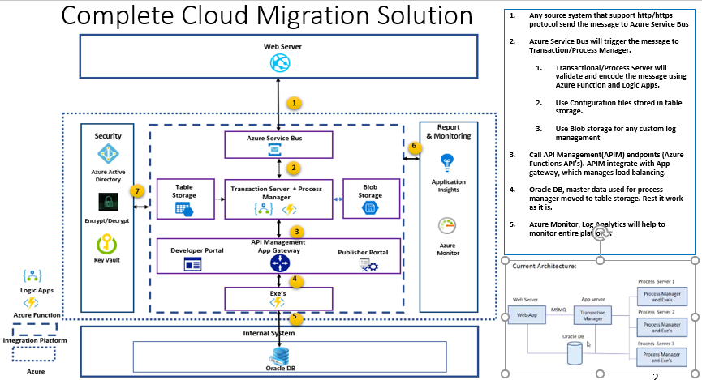

Slide 3
Thank You

